Slide 1
Hepatosplenomegaly

Slide 2
CAUSES OF HEPATOMEGALY IN NEONATES
COMMON | UNCOMMON
Biliary tract obstruction | Hepatoblastoma/hemangiomatosis
Congestive heart failure | Hemophagocytic syndrome/histiocytosis
Maternal diabetes | Isoimmunization
Malnutrition | Neuroblastoma
Metabolic disorders
Parenteral nutrition
Pseudohepatomegaly
Sepsis
Storage diseases
Viral hepatitis/TORCH infections
Wolf AD, Lavine JE. Hepatomegaly in Neonates and Children. 2017;21(9).

Slide 3
CAUSES OF HEPATOSPLENOMEGALY IN NEONATES
CAUSES | EXAMPLES
METABOLIC | Glycogen storage diseases (GSD) Lysosomal storage diseases (Gaucher, Niemann-Pick) Galactosemia Peroxisomal disorders Tyrosinemia type 1 Bile acid disorders Congenital disorders of glycosylation (CDGs, also referred to as carbohydrate deficient glycoprotein syndromes) Acid lipase deficiency (Wolman disease/cholesterol ester storage disorder) Alpha-1 antitrypsin deficiency Cystic fibrosis

Slide 4
CAUSES OF HEPATOSPLENOMEGALY AND HYPERBILIRUBINEMIA IN INFANTS
CAUSES | EXAMPLES
CONGENITAL INFECTION | Cytomegalovirus Toxoplasmosis Rubella Herpes simplex virus Syphilis HIV
ACQUIRED INFECTION | Protozoal: malaria, kalazar, amoebic Bacterial: sepsis; tuberculosis, brucellosis Helminths: hydatid, visceral larva migrans Fungal: histoplasmosis
MALIGNANCIES | Leukemia Histiocytic syndromes(haemophagocytic lymphohistiocytosis) Myeloproliferative syndromes Lymphomas
Notes:
Glycogen storage diseases (GSD)
Lysosomal storage diseases (Gaucher, Niemann-Pick)
Galactosemia
Peroxisomal disorders
Tyrosinemia type 1
Bile acid disorders
Congenital disorders of glycosylation (CDGs, also referred to as carbohydrate deficient glycoprotein syndromes)
Acid lipase deficiency (Wolman disease/cholesterol ester storage disorder)

Slide 5
CAUSES OF HEPATOSPLENOMEGALY IN NEONATES
CAUSES | EXAMPLES
IMMUNOLOGICAL | Chronic granulomatous disease Hereditary neutrophilia Ommen syndrome.
DEVELOPMENTAL | Congenital hepatic fibrosis
HAEMOPOIETIC | Haemolytic disease of newborn Thalassaemia
CONGESTIVE | Hepatic vein obstruction Constrictive pericarditis

Slide 6
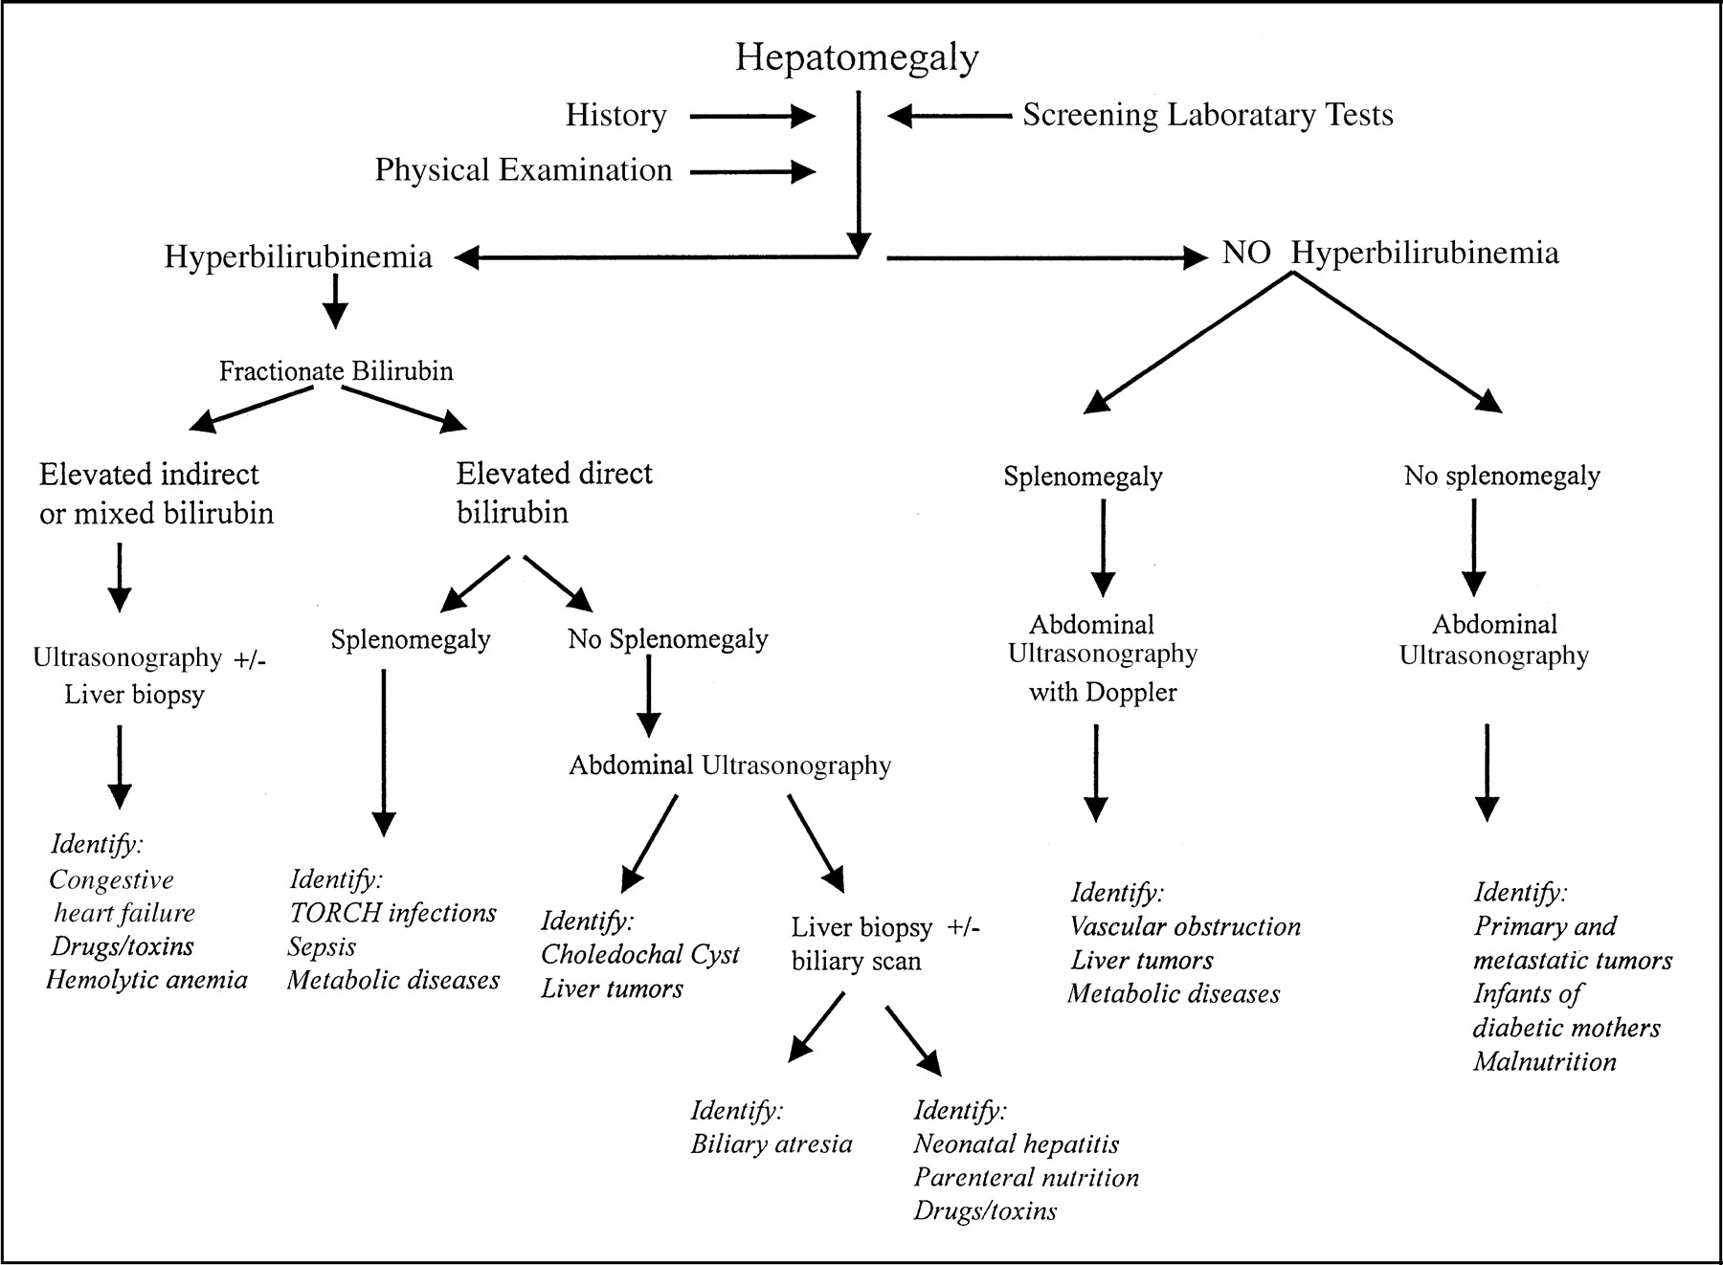
Diagnostic algorithm for hepatomegaly in neonates
Source: Wolf AD, Lavine JE. Hepatomegaly in Neonates and Children. 2017;21(9).

Slide 7
References
Uptodate
Medscape Reference
Wolf AD, Lavine JE. Hepatomegaly in Neonates and Children. 2017;21(9).
Brumbaugh D, Mack C. Conjugated Hyperbilirubinemia in Children. 2017;33(7).

